Slide 1
TCASU presentation
Jelena Rajović
Technical College of Applied Sciences Urosevac with temporary seat in Leposavic- TCASU
Kick-off meeting/ 20 December 2018
This project has been funded with support from the European Commission. This publication reflects the views only of the author, and the Commission cannot be held responsible for any use which may be made of the information contained therein.

Slide 2
About the College
Technical College of Applied Sciences Urosevac with temporary seat in Leposavic is a state school founded in 1976.
The School has a rich history of providing career-focused education and training that support economic and workforce development in our community.
Strengthening of master curricula in water resources management
for the Western Balkans HEIs and stakeholders
www.swarm.ni.ac.rs

Slide 3
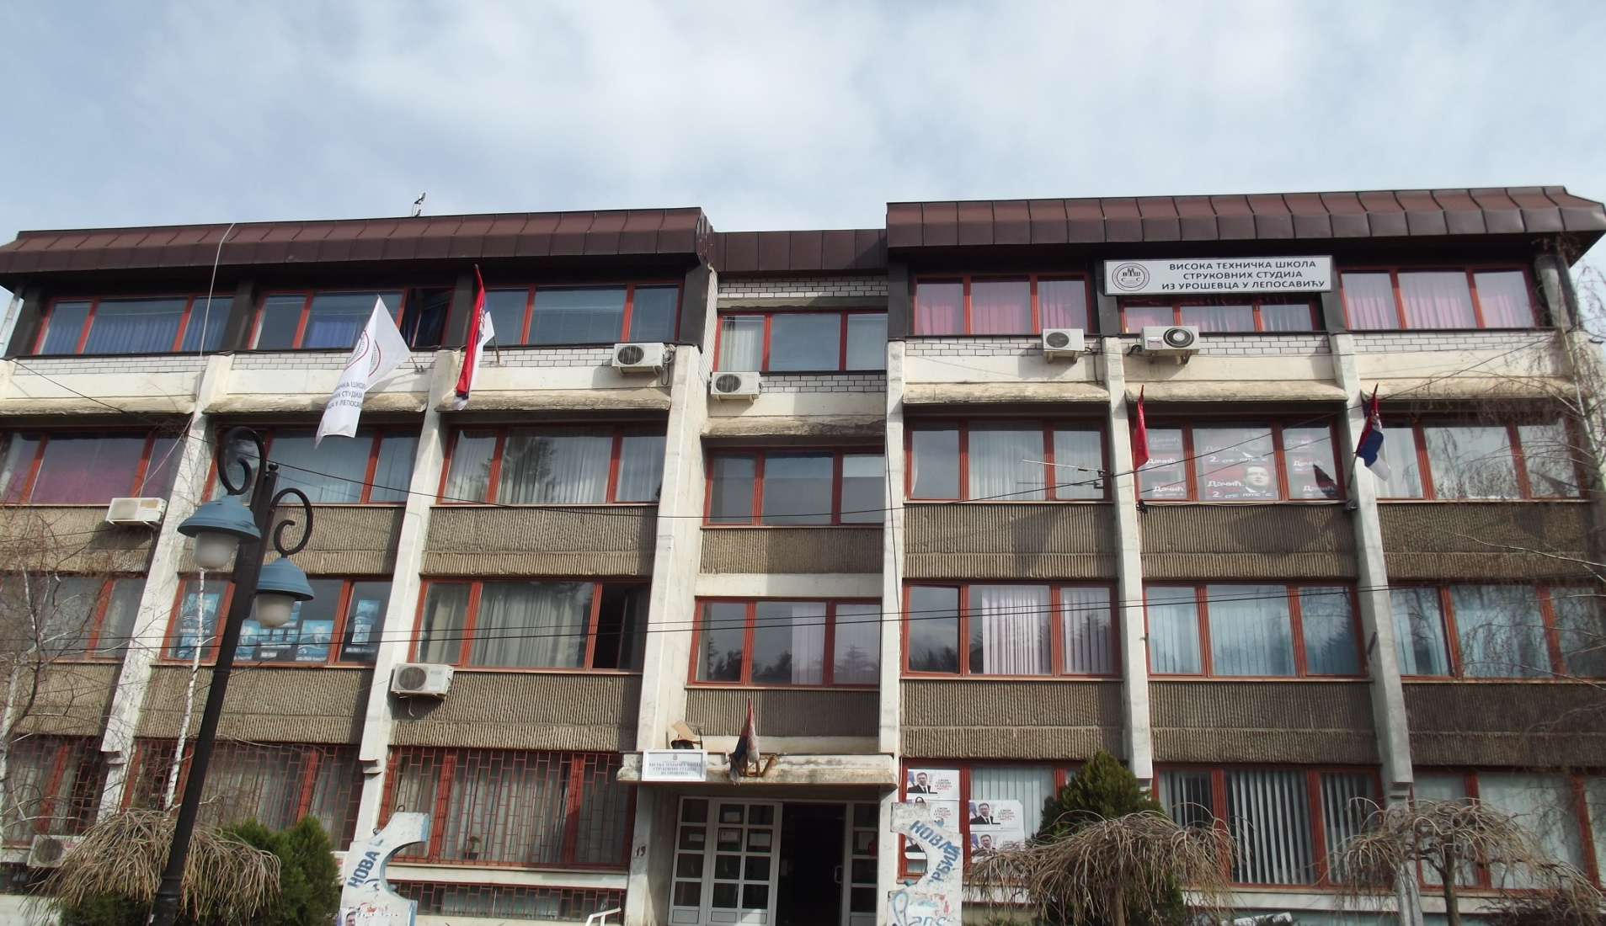
About the College
Strengthening of master curricula in water resources management
for the Western Balkans HEIs and stakeholders
www.swarm.ni.ac.rs

Slide 4
Study programs
2 programs of the first degree professional studies:
1. Road Traffic
2. Mechanical Engineering, with three
modules:
      Production engineering
      Engineering Informatics
      Occupational Safety
Strengthening of master curricula in water resources management
for the Western Balkans HEIs and stakeholders
www.swarm.ni.ac.rs

Slide 5
TCASU activities
ERASMUS+ PROJECTS:
Development of master curricula for natural disaster risk management in Western Balkan countries- NatRisk
Electrical Energy Markets and Engineering Education- ELEMEND
Improving the Traffic Safety in the Western Balkan Countries through Curriculum Innovation and Development of Undergraduate and Master Studies/TRAFSAF
Strengthening of master curricula in water resources management
for the Western Balkans HEIs and stakeholders
www.swarm.ni.ac.rs

Slide 6
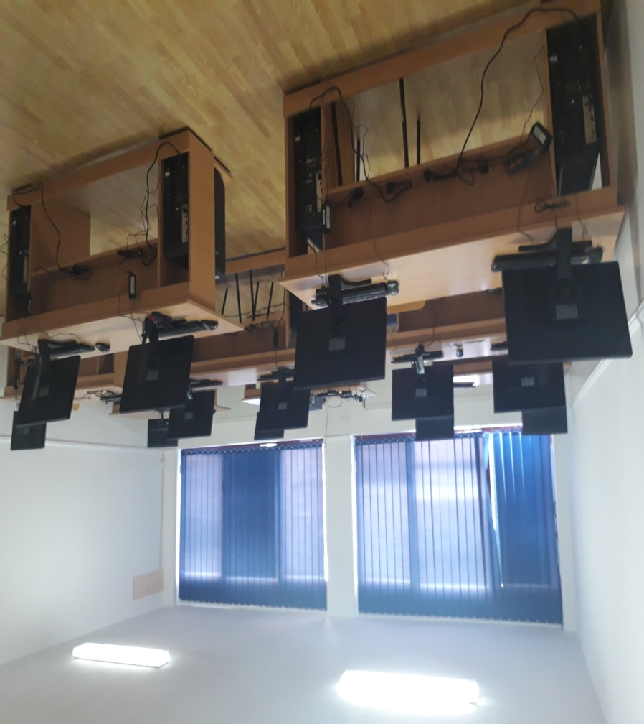
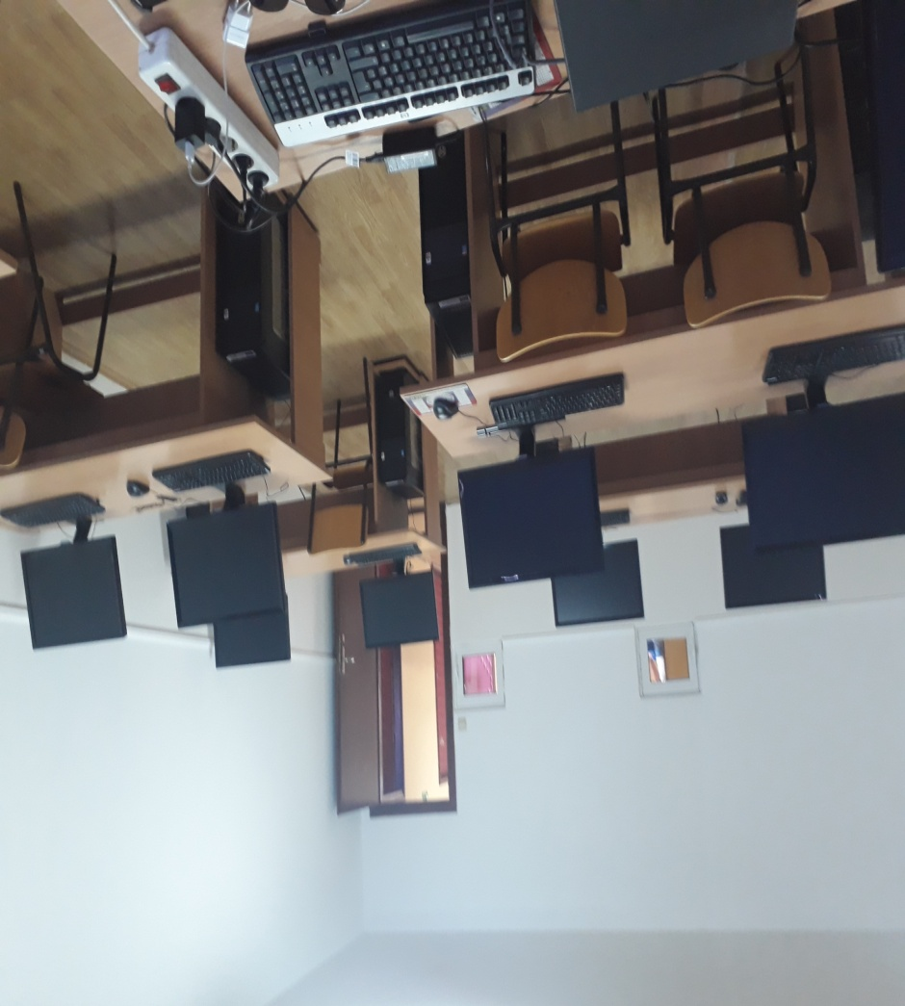
ICT Lab 1
Strengthening of master curricula in water resources management
for the Western Balkans HEIs and stakeholders
www.swarm.ni.ac.rs

Slide 7
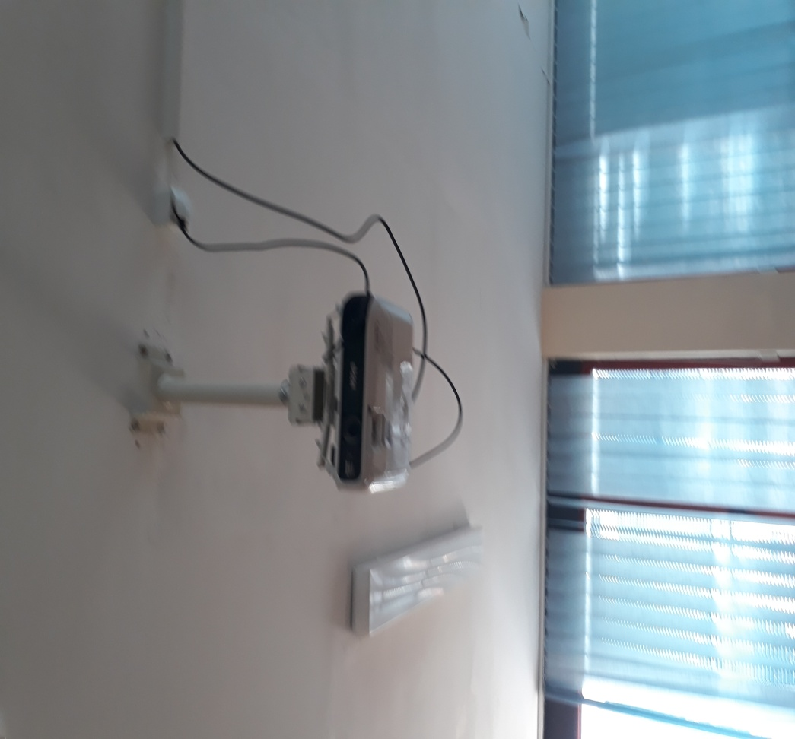
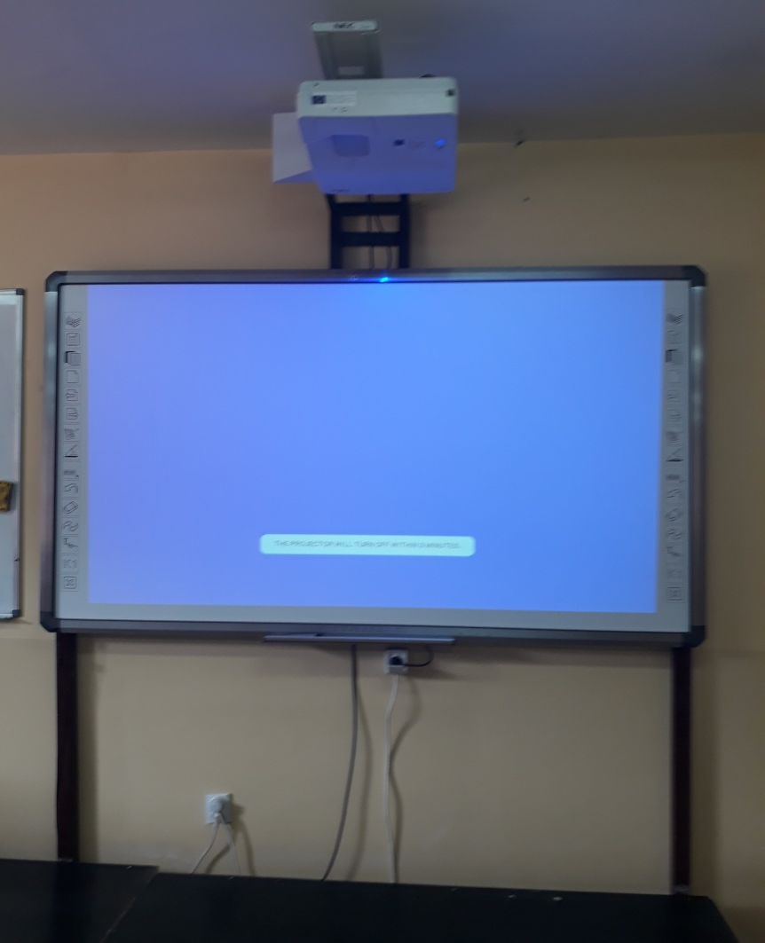
Equipment
Strengthening of master curricula in water resources management
for the Western Balkans HEIs and stakeholders
www.swarm.ni.ac.rs

Slide 8
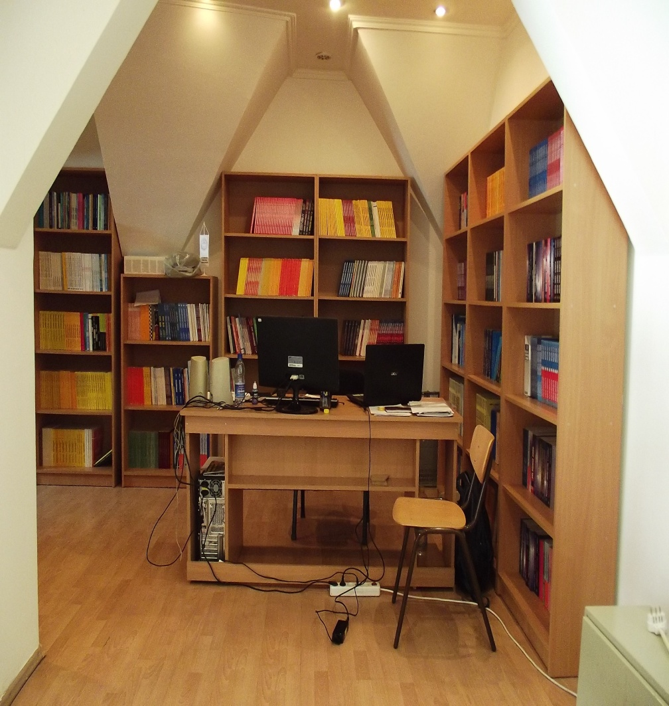
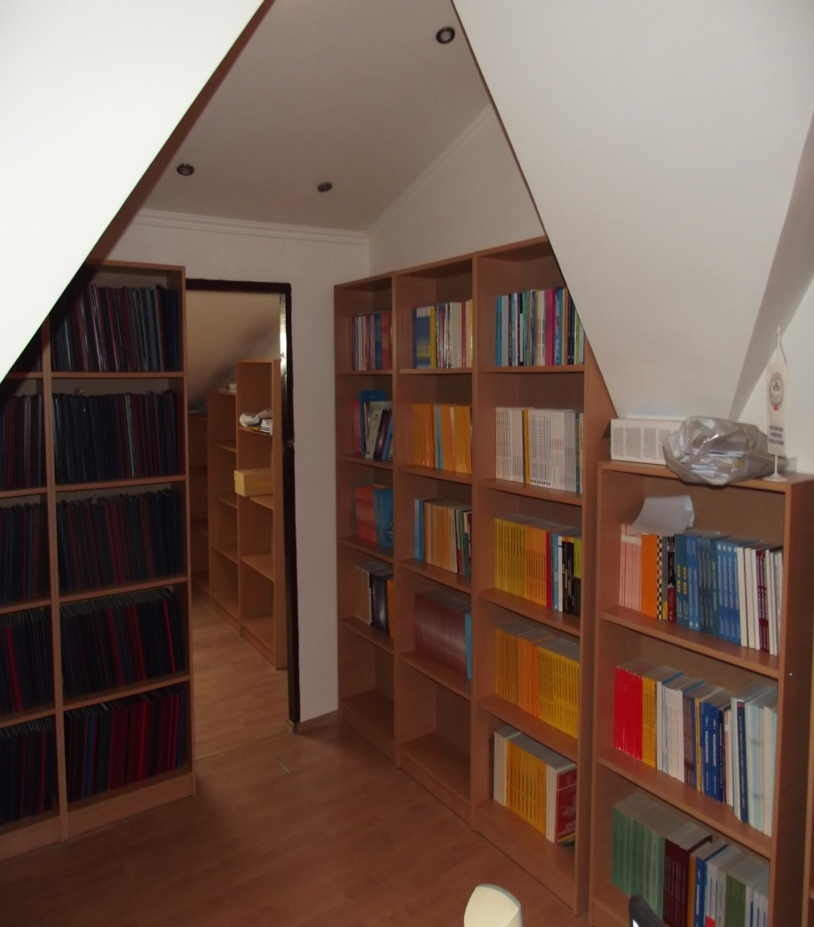
Library
Strengthening of master curricula in water resources management
for the Western Balkans HEIs and stakeholders
www.swarm.ni.ac.rs

Slide 9
Thank you for your attention
Strengthening of master curricula in water resources management
for the Western Balkans HEIs and stakeholders
www.swarm.ni.ac.rs

